Slide 1
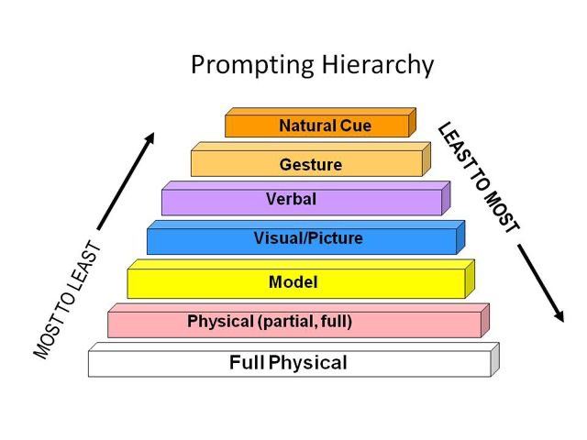
The Effects of Video Prompting on Performing the Skill of Shooting a Basketball for Children with Autism Spectrum Disorder
Pelayo, M., B.S. & Adams, D. PhD Humboldt State University
Abstract
The National Professional Development Center on Autism Spectrum Disorder recognized video prompting as an evidence based practice (EBP) for helping students with ASD.. The use of video prompting can help to improve student’s skills in sports and allow for more enjoyment and improving the amount of physical activity for students with ASD and their typically developing peers. The purpose of this study is to determine the impact of video prompting with students with ASD on the skill of shooting a basketball. The results of the study indicate that video prompting can be applied to the skill of shooting a basketball for students with ASD. However, there are limitations to the study due to the amount of participants, length of study, and data points and more research can support how video prompting can be applied to more skills and behaviors for individuals with ASD.
Social Significance
The Centers for Disease Control and Prevention (CDC) recommends that children participate in 60 minutes of moderate to vigorous physical activity each day (CDC, 2020). For children, including those with disabilities physical activity decreases the risk of health problems and improves opportunities for children to develop lifetime skills that will allow them to be physically active into adulthood. Video prompting is an EBP for children with ASD that can be implemented across a variety of context.
Purpose Statement and Hypothesis
The purpose of this study is to determine the impact of video prompting on the skill of shooting a basketball.
Video Prompting: Involves showing the participant a video model of one step of the task and then giving them the opportunity to complete that step before the net step is shown.
Methods
Participant Description
For this study one 4th grade male student was selected from a Therapeutic Learning Center Classroom. The student qualifies for Special Education Services through Autism Spectrum Disorder (ASD). The students age is 10 years old.
Setting: Joe Hamilton Elementary School outdoor basketball asphalt court located on playground.
Intervention:
For this study an ABAB withdrawal design will be implemented to determine the impact of video prompting for the skill of shooting a basketball. Video prompting includes breaking down the a particular skill into cues or steps for a task. The intervention will include using a video prompt that will include the essential elements of the skill of shooting a basketball (Knees bent, feet shoulder width apart, squared shoulders, dominant hand at center of ball, elbows bent, and follow through). The video will only display the first two elements of shooting a basketball, until the skill is performed with 70% accuracy, then the next phases of the skill will be prompted until there is 70% accuracy. The student will be shown the video prior to shooting the basketball and will have 10 opportunities to perform the skill.
Description of Intervention:
This intervention will include video prompting to teach a sequence of skills in performing a jump shot in the sport of basketball. Coaches eyes will be the displayed to the subject using an IPAD. Coaches eye breaks is a tool used video prompting so that students can see the breakdown of a particular skill, in this case it will be performing a jump shot. The skill will be broken down into smaller steps so that it can be stopped or paused to allow learner to perform specific step. This process will repeat until the entire skill (sum of the parts) is performed.
Implementation: Single subject withdrawal design (ABAB)
Implementation Fidelity:
In order to implement video prompting the researcher must have systematic trading in in the use of video prompting. They must also be trained in both phases of getting baseline and intervention data and its implementation. The data collector will need to understand the essential elements of shooting a basketball. Once training is established the measurements will be taken place through a checklist system.
Measurement Fidelity:
The design will include a set schedule for the student to exhibit his skills in shooting a basketball. We will utilize the recess time which is from 9:30am to 9:45am so that timing of the intervention is the same as baseline. The days of the week will include Tuesday’s and Thursday’s. The study will also include a checklist of the skill of shooting a basketball. Because positive reinforcement is used i throughout the day for these students, it will be implemented into the interventions throughout the withdrawal and intervention.
Research Design
Design:
A-Baseline: 3 days (no instruction, take a shot, 10 opportunities)
B-Intervention – 3 days Video Prompt (show first three components, each time he shoots then show the video prompting again)
Performance - In order to move forward and get the next set of components; participant has to performance of at least 70 % or more of the skill prompted)
A-Baseline: 2 days (no instruction, take a shot 10 opportunities)
B-Intervention: 2 days, Video Prompt (show last three components, depending on where the student is; 10 each time he shoots, then show the video prompting again)
Internal Validity
In this study maturation did not appear to occur. There was not enough time for maturation to occur. Student began the baseline with shooting at a low percentage of essential emergents and quickly changes to a high percentage in the intervention phase, then moved back to low percentage after the withdrawal of the video prompting intervention. This study could have used data points to allow for more validity in this section.
External Validity
The outcome of this study indicate that video prompting can be applied to this skill and possibly other skills in this sport and behaviors. Video prompting can be applied to students who are on the spectrum and typically developing students. Video prompting is a quick and cost effective evidence based practice to apply to more than just basketball, but to others sports, skills, and target behaviors.
Social Validity
Video prompting is a cost effective method for teaching students how to perform a skill. It requires less time and more consistency than video modeling. It also allows for the breakdown of the skill as well as cues and highlights for the student to better understand elements of the skill be learned. Normative comparisons through the CA state standards indicate that this skill is socially important and the participant is improving acceptable levels of the target behavior.
Results
Baseline Phase
For the 10 trials of shooting a basketball in the baseline phase, the participant displayed low accuracy in the essential elements of the skill. Although the participant was demonstrating a “granny shot” he still maintained to bend knees and keep feet shoulder width apart with 30% accuracy. This indicates that the student will begin the intervention with the first 3 components of the essential elements of shooting a basketball.
Intervention Phase
Based on the percentage of essential elements in the first 3 skills of shooting a basketball, the student was video prompting the entire skill. On day 4 the student was only shown the first 3 skills of shooting a basketball (knees bent, feet shoulder width apart, and squared shoulders). Because the student demonstrated more than 70% accuracy in these skills, the next phase of the skill was introduced and the student showed accuracy about 70% in all skills in days 5 and 6.
Withdrawal
During the withdrawal phase the student reverted to shooting the basketball how they lied to. This resulted in low percentages in essential elements of shooting a basketball in days 7 and 8. Once the intervention was implemented again the students performance increased to above 70% for most essential elements.
Participant Results
.
Baseline Intervention Baseline Intervention
Figure 1. Percentage of Essential Elements Performed
Discussion
The purpose of this study was to demonstrate that video prompting is an effective practice on children with ASD in performing the skill of shooting a basketball. Research has indicated that individuals with ASD have gross motor deficits. More research also supports that individuals with ASD can perform the same skills as their typically developing peers when given enough time and proper practices to help them succeed. Video prompting is an evidence based practice used for student with autism spectrum disorder. The results of the study further supports using it as a practice to help students learn a target behavior or skill. This study showed that this student needed a video prompt in order to perform the skill. The study indicates that the student needed someone to help demonstrate the skill for them and to break down the skill into phases so that the student can focus on the essential elements of the skill.
Limitations
One of the biggest limitations of this study is number of participants. If more participants are used then there will be more variables to whether video prompting is effective with students with ASD and possible other populations. The length of the study is also a limitation because this study occurred over a period of 10 days, and more days can help to ensure whether the intervention was working or not. Finally, the other limitation to recognize is the amount of data points. More data points will also help to improve the internal validity of this study.
Future Research
More research on how expanding the populations for video prompting can be an effective practice on students with ASD and typically developing peers can be researched to see if results were similar. Increasing the number of participants is also a way to show that video prompting is an effective practice moving forward. More research can also be used in demonstrating that video prompting is an effective practice in more skills moving forward. For example, basketball also includes dribbling, defending, and boxing out. Further research can show how breaking down more skills and improve basketball performance across all skills.
Essential Elements Performed | Day 1 | Day 2 | Day 3 |  | Day 4 | Day 5 | Day 6 |  | Day 7 | Day 8 |  | Day 9 | Day 10
Knees Bent | 30% | 40% | 20% |  | 70% | 80% | 70% |  | 30% | 20% |  | 60% | 70%
Feet Shoulder Width | 30% | 40% | 20% |  | 70% | 70% | 80% |  | 40% | 20% |  | 70% | 80%
Squared Shoulders | 40% | 20% | 20% |  | 50% | 90% | 80% |  | 40% | 30% |  | 80% | 90%
Elbows Bent | 10% | 10% | 40% |  | 50% | 90% | 80% |  | 30% | 20% |  | 90% | 90%
Dominant Hand at Center of Ball | 10% | 10% | 10% |  | 30% | 80% | 80% |  | 20% | 10% |  | 90% | 80%
Follow Through | 20% | 0% | 20% |  | 40% | 90% | 70% |  | 20% | 20% |  | 90% | 90%
Total | 23.33% | 20% | 21.66% |  | 51.67% | 83.33% | 81.67% |  | 30% | 20% |  | 80% | 83.33%
For additional information, such as references or other related questions within this investigation contact Miguel Pelayo map33@humboldt.edu

