Slide 1
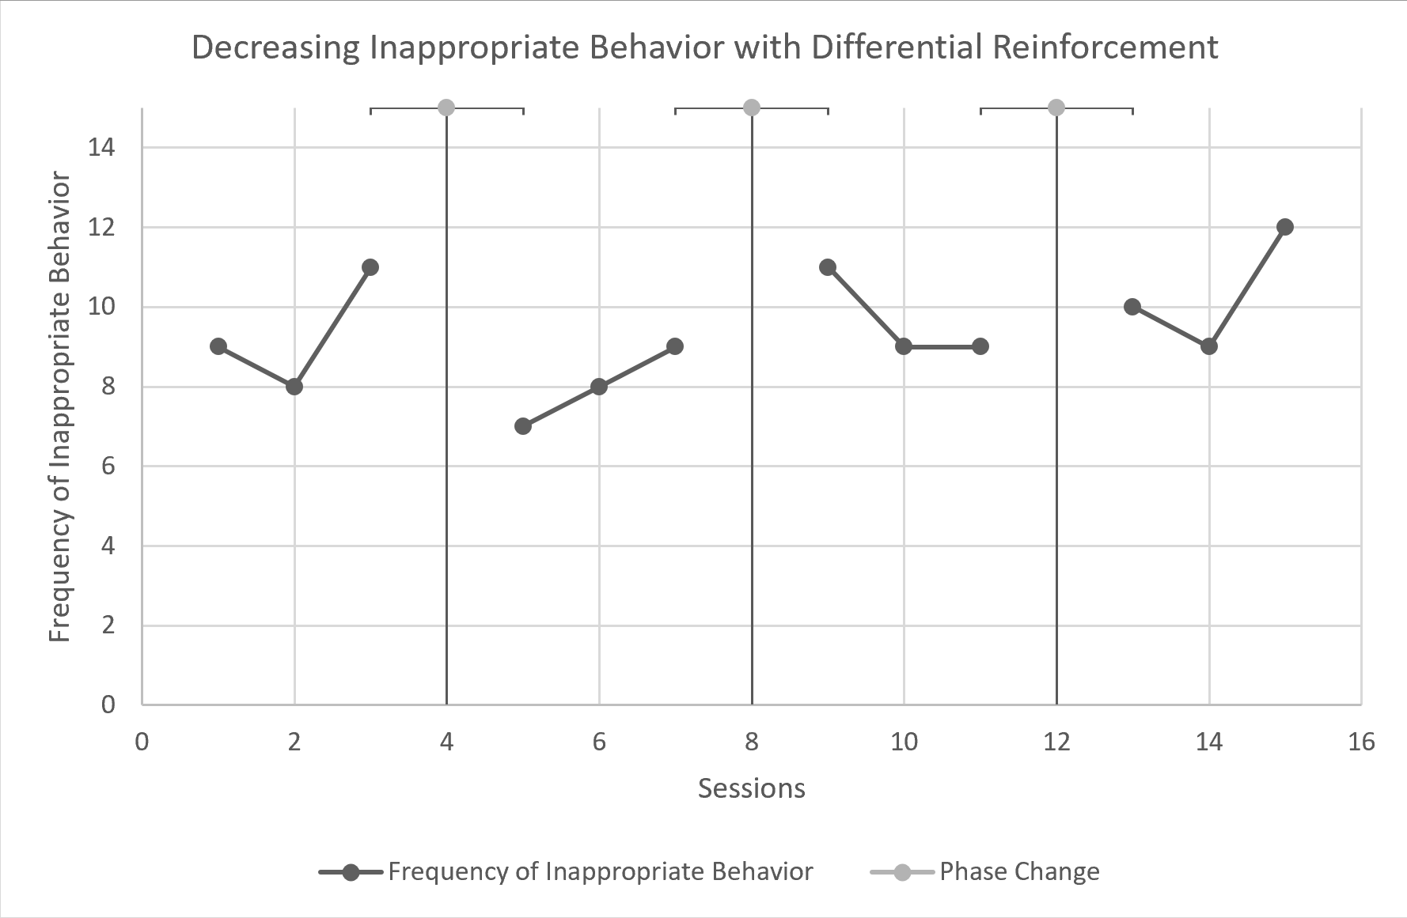
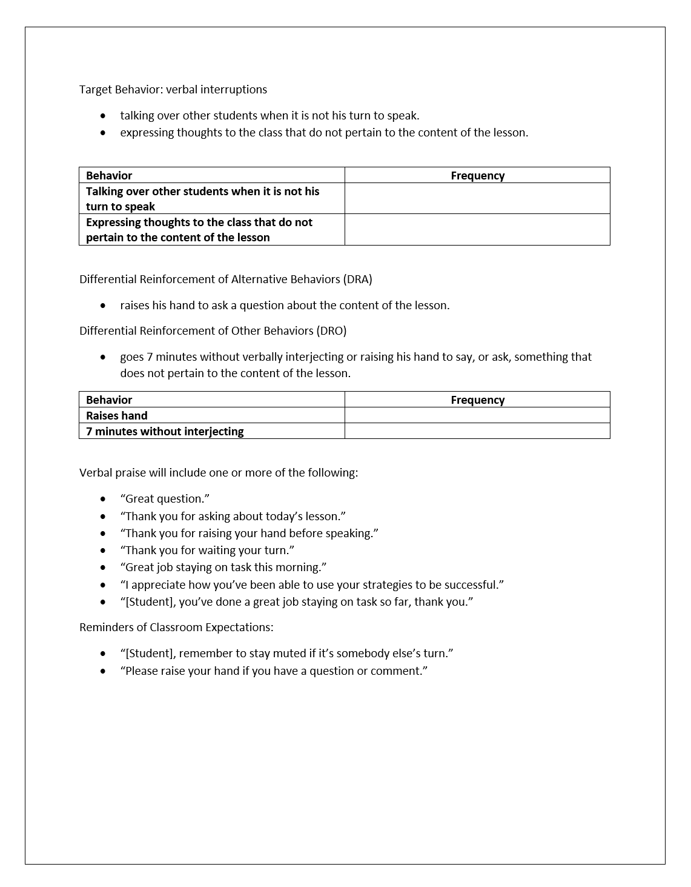
Differential Reinforcement as a Means of Decreasing Inappropriate Behaviors in Elementary Children in the Distant Learning Environment
Andrew Beesley, David Adams, PhD
Abstract:
This study explores the efficacy of Differential Reinforcement (DRO), specifically Differential Reinforcement of Alternate Behaviors (DRA) and Differential Reinforcement of Other Behaviors (DRO), in reducing disruptive behaviors from students by using verbal praise to increase the occurrence of appropriate behaviors. The intervention of this four-week study was applied in the distance learning environment of a 3rd-5th grade Special Day Class. The study lasted a total of 12 sessions. The results of this study show insignificant differences between baseline data, and intervention data.
Social Significance
Reducing disruptive behaviors in a classroom is beneficial to the educational experience of all students in that environment, including the student engaging in disruptive behaviors. Research has indicated Differential Reinforcement (DR) is an effective, evidence-based practice for reducing behaviors which could disrupt the participation in desired behaviors such as learning and social interactions (Savage & AFIRM, 2017). By using DR in the classroom, the participant was reinforced for not engaging in interfering behavior (DRO), and for spending time participating with appropriate behaviors (DRA). Given the distance learning environment, and the existing, classroom-wide token economy, verbal praise was chosen as the method of reinforcement.
Purpose
The purpose of this study was to determine if Differential Reinforcement (DR), in the form of verbal praise, would decrease the occurrence of disruptive behavior and increase the occurrence of appropriate behavior in the distance learning classroom.
Hypothesis
Differential Reinforcement (DR) will decrease the frequency of inappropriate behaviors within the distance learning classroom, when using verbal praise as the method of reinforcement.
Method
Participant
The participant of this study is 9-year-old student in the third grade. He qualifies for Special Education under the IDEA (2004) with a Specific Learning Disorder by exhibiting processing deficits in cognitive abilities and attention, as determined by the Kaufman Assessment Battery for Children-2 (KABC-2), Kaufman Test for Educational Achievement-3 (KTEA-3), and Tests of Neuropsychological Processing-2 (NEPSY-2). He attends a 3-5 Special Day Class for Specialized Academic Instruction in Math, Reading, and Writing. He was nominated by his instructor, an Education Specialist, as someone who might benefit from intervention due to the high frequency of his verbal interruptions.
Setting
The setting of this study was a 3-5 Special Day Class for Specialized Academic Instruction in Math, Reading, and Writing. Instruction took place in a distance learning environment due to the Coronavirus pandemic, from 8:45am to 12pm, Tuesday through Friday. The virtual classroom had three instructors, including the Aide and student teacher, and 12 students. To begin the day, students received whole group instruction before moving to an A-B model for Math instruction. Both Group A and Group B consisted of a total of six students, or two students per instructor. It was during Math instruction that the participant received the intervention. After both groups had received Math instruction from instructors, students then received instruction in reading and writing.
Dependent Variable
The target behavior in this study was talking over other students when it was not his turn to speak and expressing thoughts to the class that do not pertain to the content of the lesson. This study recorded the frequency of target behaviors throughout baseline and intervention phases.
Independent Variable
DR is used to both decrease the frequency of inappropriate behaviors and increase the frequency of desired behaviors. The National Professional Development Center (NPDC) on Autism Spectrum Disorder determined DR to be an effective EBP in 2014 (NPDC, 2014). Through the review of 25 single case design studies, DR has been determined to be an effective intervention for students anywhere from 3 to 22 years old, and can be used to address “social, communication, behavior, joint attention, play, school readiness, academic, motor, and adaptive outcomes” (Savage & AFIRM, 2017).
Research Design
Baselines
The first phase of the study was spent measuring baseline data. While the instructor was giving Math instruction, he recorded the number of times the student spoke out of turn or expressed thoughts that did not pertain to the lesson. Baseline data was again recorded in the third phase of the study by the student teacher and researcher.
Intervention
In the second phase of this study, the intervention was Differential Reinforcement of Alternative Behaviors (DRA), Differential Reinforcement of Other Behaviors (DRO), both using positive verbal praise as the method of reinforcement. The participant received verbal praise when he raised his hand to ask a question or express a thought about the lesson, and when he spent seven minutes without verbally interjecting or raising his hand to say, or ask, something that did not pertain to the content of the lesson. In the fourth and final phase of this study, the intervention included both DRA and DRO as well as reminders of classroom expectations. Verbal praise was given for the same desired student behaviors as in the second phase of the study.
Figure 1
Internal Validity
This study took place over the course of four weeks during 30-minute sessions to ensure that History and Maturation did not affect results. There is no test the participant was required to take. The participant had two instructors throughout this study, his regular instructor and the researcher. The occurrence of his behaviors were recorded on a copy of the same checklist every day, and the same six phrases of scripted verbal praise were used by both the instructor and researcher. The participant attended small group instruction with the same two student peers every day. All data recorded for this study was recorded during the 9:45 to 10:15 small group math instruction.
External Validty
Positive results in this study would show that Differential Reinforcement, specifically Differential Reinforcement of Alternative Behaviors (DRA) and Differential Reinforcement of Other Behaviors (DRO), is effective at reducing the occurrence of interruptive behaviors in class. It would prove that verbal praise is an effective form of positive reinforcement to help decrease the frequency of inappropriate behaviors and increase the frequency of desirable behaviors, and that verbal praise is an effective form of positive reinforcement to increase the amount of time between undesirable behaviors.
Social Valdity
Prior to implementing this EBP, the student’s instructor and the instructor’s Aide were interviewed using a questionnaire with a Likert Scale from 1 to 5 (1 being no change at all and 5 being extremely beneficial change). They answered three questions: 1) How much, if any, would the participants educational experience improve with fewer class interruptions, 2) How much, if any, would the educational experience of other students improve with fewer classroom interruptions, 3) How much, if any, would the student’s social experience at and outside of school improve? Both the teacher and the Aide answered 5 to each question, indicating that the subject of the study, as well as the students in the class, would experience an improved educational environment if the behaviors were addressed. Additionally, their answers to the third question indicated that they thought these behaviors were important to the subject’s social relationships outside of the classroom.
Results
Figure 2
Participant
In week 2 of the study, after baseline data had been recorded, the frequency of the participants behavior decreased by an average of 13.98% from the first week. In the fourth week of the study, the frequency of the participants behaviors increased by 6.80% from the third week and increased by 9.71% from the first week.
Social Validity
Although DR has been determined to be an effective EBP for students in the participants age group, the primary function of his behaviors were attention seeking, and there might be a more suitable EBP to the individual in question. Additionally, verbal praise might be more effective as a method of reinforcement when coupled with a reward system or token economy.
Discussion
Although DR has been determined to be an effective EBP at increasing the occurrences of appropriate behaviors, especially in students aged 6-14, the results of this study did not reflect past research. Due to the limitations of this study, the available data recorded is inconclusive. The results of this study do not indicate using positive verbal praise as a method of reinforcement with DRO and DRA, coupled with consistent reminders of classroom expectations, will significantly increase the number of appropriate behaviors in the distant learning environment. Future research with DR should be conducted in the distance learning to determine whether verbal praise is an effective method of reinforcement and should be done over a longer period of time, with multiple participants to provide more data points, and hopefully more determinant data.
Andrew Beesley, David Adams, PhD

