Slide 1
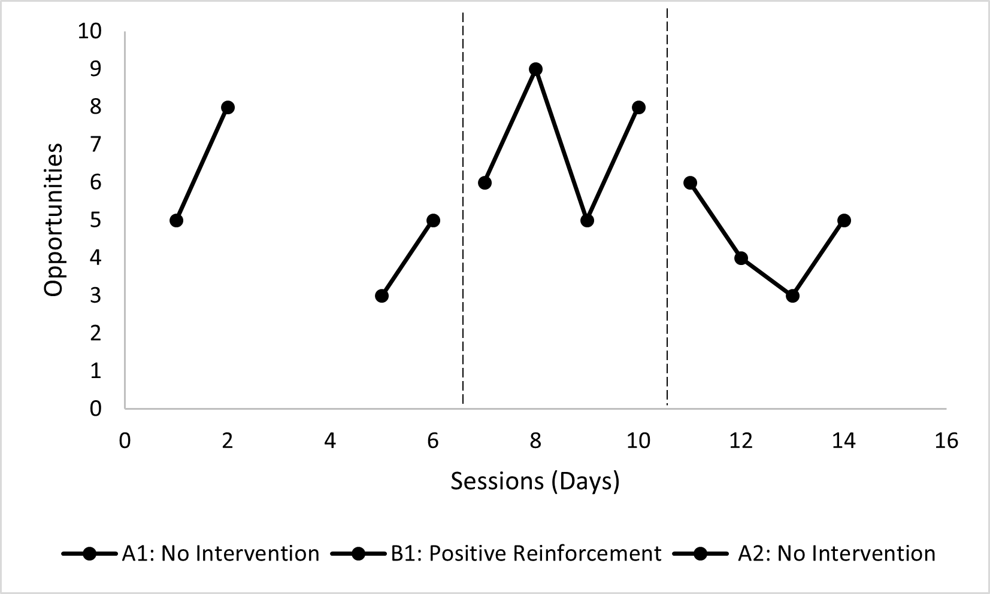
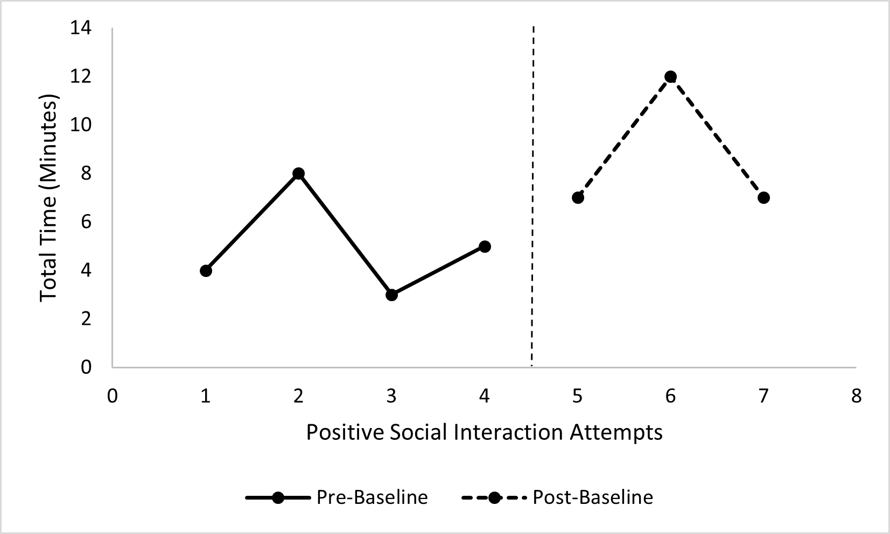
The Impact of Positive Reinforcement on Duration of Positive Social Interaction During Physical Activity in Physical Education for Students with Disabilities
Melaina Valdez, David Adams, PhD
Abstract
Children with disabilities are less likely to engage in positive social interactions than their typically developing peers. Reinforcement (R+), an evidence-based practice, describes the relationship between learner behavior and a consequence that follows the behavior, where the relationship between the learner’s use of a skill or behavior and the consequence is only reinforcing if the consequence increases the likelihood the learner performs the skill or behavior. R+ has shown positive results in changing behaviors and acquiring new skills in previous research, and interpretation of the study results align with prior studies outcomes. Due to the limitations within this study, it is important that researchers continue to study the effects R+ has on increasing the duration of positive social interactions during physical activity (PA) in children with disabilities.
Social Significance
Researchers have demonstrated that PA increases overall physical health along with decreasing the risk for heart or respiratory diseases, as well as providing significant opportunities for social interactions (Todd & Reid, 2006).
R+ is a common behavior management technique used by teachers, including special educators, as well as therapists, paraprofessionals, early interventionist and community-based programs, and even by parents in their homes. Reinforcement describes the relationship between learner behavior and a consequence that follows the behavior where the relationship between the learner’s use of a skill or behavior and the consequence is only reinforcing if the consequence increases the likelihood the learner performs the skill or behavior (Sam & AFIRM, 2015).
Purpose
The purpose of this study was to determine if R+ increases the duration of positive social interaction during PA for students with disabilities in the physical education setting.
Hypothesis
The researcher believe the implementation of R+ as an intervention in the physical education setting will increase the duration of positive social interaction during PA.
Method
Participant
The participant of this study is a 13-year-old male with Fragile X Syndrome and qualifies for special education under Other Health Impairment with a diagnosis of Fragile X Syndrome, generalized anxiety disorder, and receptive/expressive and academic delays. Due to the participants diagnosis, they experience social anxiety and withdrawal in physically active group settings, as well as fine and gross motor deficits, qualifying them for adapted physical education services. The participant was selected based upon (1) the placement of the author’s student teaching assignment in their special education credential program, (2) participant’s qualification for adapted physical education, (3) participant’s placement in a physical education class, and (4) the participant’s low positive social interactions in physically active group settings.
Dependent Variable
The target behavior of this study is duration of positive social interactions during PA in a physical education setting. This study will look at the duration of time the target student engages in positive social interactions during physical activity in a physical education setting within 50-minute sessions.
Independent Variable
R+ is used to teach target skills and increase desired behaviors. R+ was determined an evidence-based practice by criteria set by the National Professional Development Center on Autism Spectrum Disorder (NPDC, 2014) with 43 single case design studies (Sam & AFIRM, 2015). Literature between 1990 and 2011 were reviewed and reported in their NPDC 2014 Evidence-Based Practice Report. This report states that R+ has been effective for students with ASD from birth to age 22, and can be used effectively to address social, communication, behavior, joint attention, play, cognitive, school readiness, academic, motor, adaptive, and vocational outcomes (Sam & AFIRM, 2015).
Research Design
Baselines
During Baseline Phase 1, the research assistant sat or stood at the parameter of the physical activity area for observation. Data was collected on whether the student was engaged in positive social interaction during the activity or not every 5 minutes, allowing a total of 10 opportunities. Baseline (A1) data was collected in two sets of two consecutive school days for a total of 4 days.
During Baseline Phase 2, data was collected using the same procedures as Baseline Phase 1 (A1). Baseline Phase 2 (A2) data was collected across 4 consecutive school days.
Intervention
During the Intervention Phase 1, the participant was shown the reinforcer menu and instructed to engage in positive social interactions with peers during physical education. The research assistant stood at the parameter of the PA area for observation and to administer positive reinforcement when the participant used the target behavior. If the student was engaged in positive social interaction during PA, the student received R+ predetermined by the reinforcer menu (e.g. receives a Hi-Chew). At the conclusion of the fourth day R+ was removed from the participant. Intervention (B1) data was collected across 4 consecutive school days.
Internal Validity
This study took place over 5 weeks in 50-minute sessions to ensure history and maturation have no effect on results. The participant had access to the same 5 peers during each data collection session in the Baseline and Intervention Phases. Use of the reinforcer menu attributed to the student’s motivation to continue receiving the intervention during Intervention Phase 1.
Duration Data Collection Sheet was used prior to Baseline (A1, A2) data collection to structurally observe target student and behavior to determine appropriateness of EBP. Interviews of SDC teachers (Educator 1, Educator 2), research assistant (SCIA), and Adapted Physical Education Consultant were conducted to assure data collection results. Duration Data Collection Sheet was used a final time one week after the completion of the study to test fidelity of the study results.
All research assistants (SCIA, Educator 1, Educator 2, paraprofessional) were trained in using the data collection tool (Duration Data Collection Sheet, Time Sampling Data Collection Sheet) and procedures for data collection.
External Validity
Results from this study indicate that R+ can increase the duration of time of positive social interaction during PA for students with disabilities in a physical education setting as well as increase the amount of time spent during PA in the physical education setting engaging positively with their peers. These positive engagements have the potential of transferring to daily social activities outside of the physical education setting and positively affect leisure and recreation experiences. This study should be replicated within the setting of physical education and target student with disabilities who have low positive engagement with peers during PA in the physical education setting.
Social Validity
Prior to the study, the student had been receiving various forms of reinforcement, including verbal praise and negative reinforcement. Prior to and upon completion of the study, the primary researcher interviewed both SDC teachers (Educator 1, Educator 2), the student’s SCIA, and the student’s Adapted Physical Education Consultant about whether they thought R+ in the form of a reward system was an appropriate intervention for the target student and if they would be comfortable continuing to use R+ in the form of a reward system after the completion of the study. All interviewees agreed that R+ was the most appropriate EBP for the target student in the target setting.
Results
Figure 1
Figure 2
Participant
The participant’s engagement increased by 33.3% with the use of positive reinforcement, and when removed decreased engagement by 35.7%. These results indicate the intervention was successful in increasing the participant’s engagement in positive social interaction during PA in the physical education setting.
The participant averaged a duration of 5 minutes engaged in positive social interaction during physical activity in pre-baseline and averaged a duration 8.67 minutes of engagement after the implementation of the study in the post-baseline phase. This is an 73.4% increase as the participant increased duration average by 3.67 minutes and indicates the intervention improved duration of engagement.
Social Validity
All research assistants and interviewees agreed that R+ was the most appropriate EBP for the target student in the target setting. All interviewees agreed continuing to use R+ in the form of a reward system after the completion of the study would be beneficial for the target student, and all agreed R+ was the appropriate measure for the targeted outcome.
Discussion
R+ has shown positive results in changing behaviors and acquiring new skills in previous research, and interpretation of the study results align with prior studies outcomes. In one study involving sustained PA of individuals with disabilities (Todd & Reid, 2006), R+ increased the number of circuits of PA completed by the participants. Kosma, Cardinal, and Rintala (2002) suggest R+ “couple with determining her/his own reward system, the individual should experience positive affect” (p.120). The reinforcer menu to provide R+ resulted in the targeted response and behavior change. Limitations to consider include the number of participants, the duration of the study, inconsistent days of data collection, amount of data collected, and implementation of the intervention and data collection across both specially designed and general physical education settings. It is recommend future researchers increase the number of participants and the duration of the study, increase the amount of data collected consecutively in each phase, and implement the intervention and data collection in a single physical education setting.
Melaina Valdez, David Adams, PhD
Citations
Gable, R. A. (1991) from: Cartwright, C. A., & Cartwright, G. P. (1970). Determining the motivational systems of individual children. Teaching Exceptional Children, 2:3, 143-149. Forced-Choice Reinforcement Survey.
Maria Kosma, Bradley J. Cardinal & Pauli Rintala (2002) Motivating Individuals With Disabilities to Be Physically Active, Quest, 54:2, 116-132
Mason, S. A., & Egel, A. L. (1995). What does Amy like? Using a mini-reinforcer assessment to increase student participation in instructional activities. Teaching Exceptional Children, 28, 42-45.
Sam, A., & AFIRM Team. (2015). Reinforcement. Chapel Hill, NC: National Professional Development Center on Autism Spectrum Disorder, FPG Child Development Center, University of North Carolina.
Todd, T., & Reid, G. (2006). Increasing physical activity in individuals with autism. Focus on Autism and Other Developmental Disabilities, 21(3), 167-176.
Williams, J. A., Koegel, R. L., & Egel, A. L. (1981). Response-reinforcer relationships and improved learning in autistic children. Journal of applied behavior analysis, 14(1), 53–60.

