Slide 1
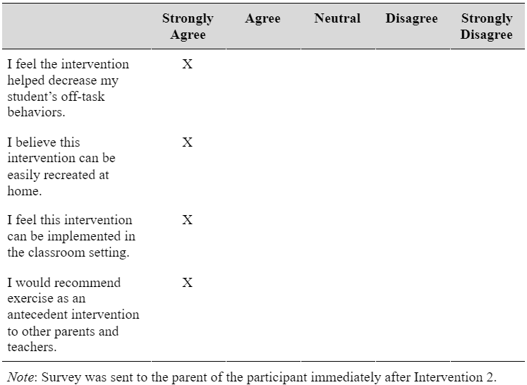
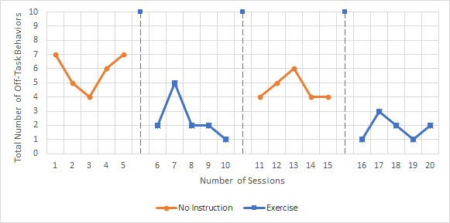
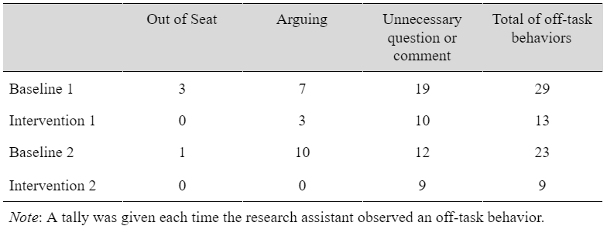
Exercise Intervention to Improve Off-Task Behaviors During At-Home Learning
Delaney Hughes
Abstract:
The Department of Health and Human Services recommends 60 minutes of moderate-to-vigorous physical activity per day for school aged children (Physical Activity Guidelines for Americans, 2018). Due to at home learning, many students no longer reach the Physical Activity Guidelines and struggle with off-task behaviors. The objective of this experiment was to determine if off-task behaviors during at-home learning for an elementary aged student could be reduced by implementing an exercise program directly before the unpreferred class. Results suggest that with a 15 minute exercise routine, the participant’s off-task behaviors in her unpreferred class improved. These results align with past research that has demonstrated the benefits of exercise interventions improving academic performance and on-task behaviors in the classroom setting.
Social Significance
According to the Department of Health and Human Services Physical Activity Guidelines, school aged children (ages 6-17 years) should complete approximately 60 minutes of moderate-to-vigorous physical activity per day. Regular physical activity in childhood helps improve motor skills and teaches a child healthy habits that can promote lifelong health (Physical Activity Guidelines for Americans, 2018). Due to at home learning, many students may no longer reach the daily physical activity guidelines and struggle with off-task behaviors. Research has suggested that exercise throughout the day can help with a student’s academic performance, including off-task behaviors.
Purpose
The purpose of the experiment is to determine the impact of an exercise program on the total number of off-task behaviors demonstrated during online school for an elementary aged individual.
Hypothesis
The researcher believes the exercise program will have a positive impact and decrease the total number of off-task behaviors demonstrated by the participant.
Method
Participant
The participant is a typically developing 7-year-old first grade student currently partaking in virtual learning at home. The participant was selected as she is between the ages of 5 and 9, currently attends school through distance learning from home, and the parents of the participant reported she had difficulty staying on task during online instruction. Additionally, the parents reported that the participant is no longer reaching the daily physical activity guidelines recommended for children. The participant completed all virtual learning from the dining room table at the home. The participant’s mother is around to supervise, but is not there continuously because of the need to provide academic support for her older brother. The exercise routine was completed in the living room over Zoom.
Dependent Variable
The dependent variable is off task behaviors observed during the participant’s math class.
Independent Variable
The independent variable is a 15 minute exercise routine prior to the student’s math class with the researcher over a Zoom meeting.
Research Design
Baseline Phases
Baseline Phases of the study began with the participant observed for 30 minutes in her math class for approximately 5 days. The research assistant collected data on the child’s off-task behaviors that consisted of getting out of her chair, unnecessary questions and comments, and arguing.
Intervention Phases
The Intervention Phases consisted of an exercise routine with the researcher. The routine was a 15 minute video by YouTuber ‘GO WITH YOYO- Fitness Fun for Kids’, and completed with the researcher over a Zoom meeting. Post intervention the participant moved directly into her math class. The research assistant continued the same data collection that occurred within the baseline phases.
Internal Validity
To provide internal validity, the participant was not told she is being observed during math class and did not know why she was participating in an exercise program. The use of the ABAB withdrawal design provided reassurance that the change in the dependent variable was caused by the independent variable. Internal validity was also demonstrated by stable data points throughout each phase of the study.
External Validity
Regular physical activity in childhood helps improve motor skills and teaches a child healthy habits that can promote lifelong health (Physical Activity Guidelines for Americans, 2018). According to the Department of Health and Human Services Physical Activity Guidelines, school aged children (ages 6-17 years) should complete approximately 60 minutes of moderate to vigorous physical activity per day. Due to at home learning, many students are no longer given the opportunity to participate in the different physical activities offered in the school setting and many no longer reach the exercise standards recommended for children. Implementing a 15 minute exercise intervention daily is important since it can possibly help with children’s off task behaviors during virtual learning as well as help children reach the recommended physical activity guidelines.
Social Validity
To provide social validity, the parents of the participant were given a survey post Intervention Phase 2 to speak about their experience in the study. The survey asked questions to provide information on their belief if the exercise intervention was feasible, effective, and able to be maintained.
Results
Participant
The number of off-task behaviors observed by the research assistant in math class are shown in Figure 1 and 2. In Figure 1, we see the total number of observed off-task behaviors each day in the baseline and intervention phases. As seen in Baseline Phase 1 with ‘no instruction’, the participant shows a higher level of off-task behaviors that begins to decrease as Intervention Phase 1 begins and exercise is implemented. In Baseline Phase 2, the participant received ‘no instruction’, and once again the number of off-tasks behaviors began to rise with an immediate decrease in the Intervention Phase 2.
Figure 1
Participant’s Number of Off-Task Behaviors During Math Class
In Figure 2, secondary data was collected on the total number of specific off-task behaviors including the participant getting out of her seat, arguing, and unnecessary questions and comments. Baseline Phase 1 and 2 observed significantly more off-task behaviors, exhibiting that an exercise routine directly before an unpreferred class may decrease the total number of off-task behaviors a student has.
Figure 2
Total Number of Off-Task Behaviors Observed in Each Phase of the Study
Social Validity
To determine social validity of the experiment, the researcher sent the mother of the participant a survey with 4 questions. As seen in Figure 3, the mother of the participant believes the intervention to be effective in improving the participant’s off-task behaviors in her unpreferred class. She also believes that the intervention can be easily recreated in both the home and classroom setting. The participant’s mother is a third grade teacher and stated that she plans to implement exercise in her future classes
Figure 3
How much do you agree with the following statements?
Discussion
In a study by Howie (2014), 4th and 5th grade students were divided and received 4 different interventions, no exercise break, 5 minutes, 10 minutes, or a 20 minute exercise break. Following the exercise, the students were recorded and observed to determine time-on-task scores. Similar to the study conducted, students on-task behaviors improved when they received a 10 exercise break. Results in the study also showed that an exercise break had a positive relationship with academic performance. A study by Mahar (2006) also found that the intervention group, consisting of 135 students in grades K-4th, observed improvement in the student’s on-task behaviors. The intervention being a classroom based physical activity program consisting of 10 minute physical activities. The results in both the research studies iterate the effectiveness of short bursts of exercise improving off-task behaviors.
The main limitations of the study are the amount of participants and the length of the study. Since the study only includes a single participant, it is difficult to determine if exercise as an antecedent intervention would be effective in a classroom setting or with students above the age of 7. Lengthening of the study to collect more data points can help improve the connection between exercise and off-task behaviors, especially because there was slight variation in the participant’s off-task behaviors during her baseline phases. Future research focus should center on the effectiveness of exercise as an antecedent intervention in the classroom setting when multiple students, including students with disabilities, are involved. While there is some research of exercise as an intervention in the classroom setting, future research should implement the exercise routine in special education classrooms to see if exercise is effective in improving on-task behaviors for students with disabilities. If research can provide evidence that short bursts of exercise improves off-task behaviors for students with a multitude of abilities in the classroom, teachers can implement more exercise throughout the day and increase the amount of moderate-to-vigorous physical activity students receive in total as well as improve off-task behaviors.
Citations
Mahar, M. T., Murphy, S. K., Rowe, D. A., Golden, J., Shields, T., & Raedeke, T. D. (2006). Effects of a classroom-based physical activity program on physical activity and on on-task behavior in elementary school children. Medicine & Science in Sports & Exercise, 38(Supplement). doi:10.1249/00005768-200605001-01239
Shephard, R. (2012). The association between school-based physical activity, including physical education, and academic performance: A systematic review of the literature. Yearbook of Sports Medicine, 2012, 358-359. doi:10.1016/j.yspm.2011.07.013
US Department of Health and Human Services. Physical Activity Guidelines for Americans, 2nd edition. Washington, DC: US Department of Health and Human Services; 2018.
Delaney Hughes

