Slide 1
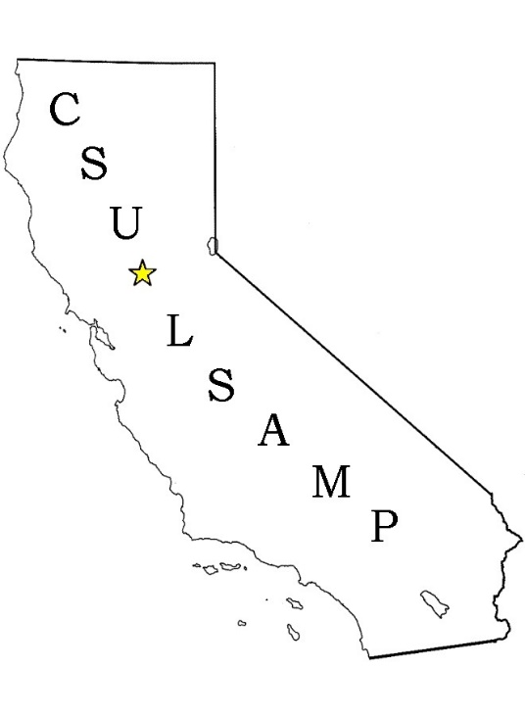
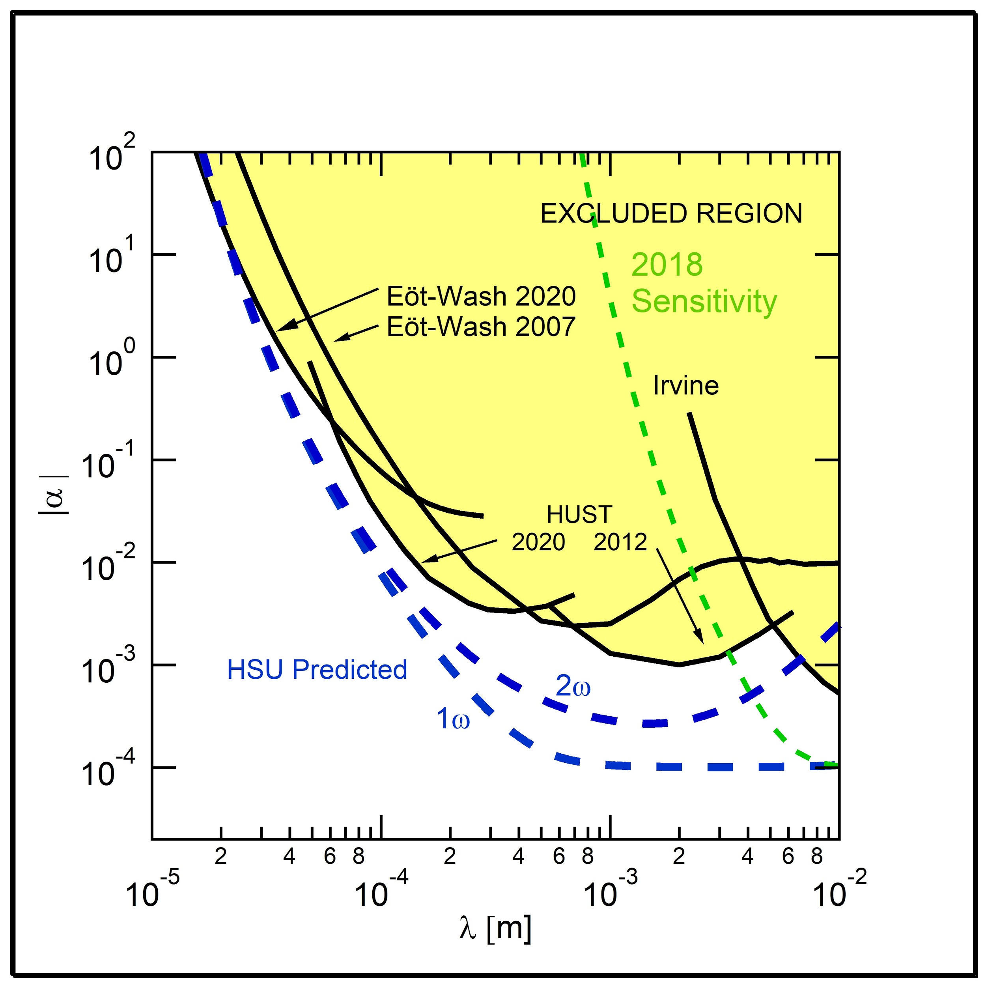
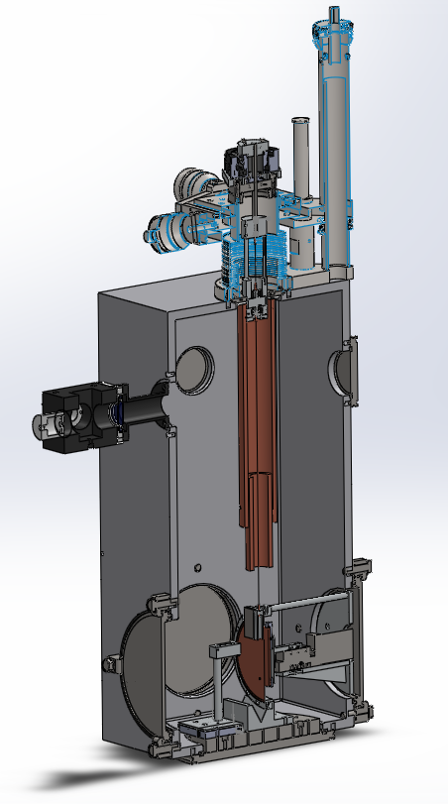
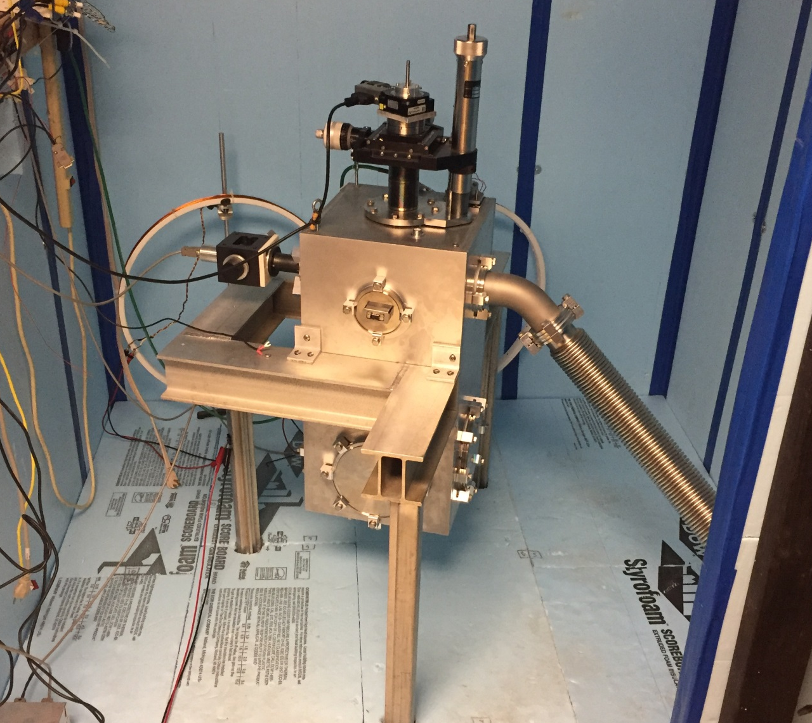
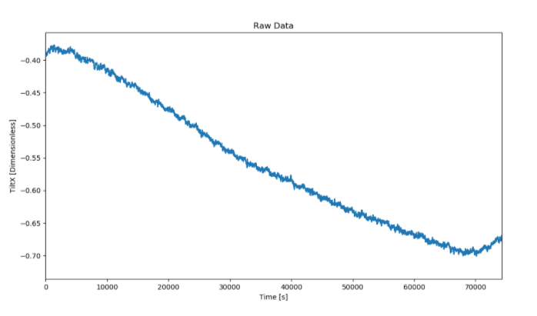
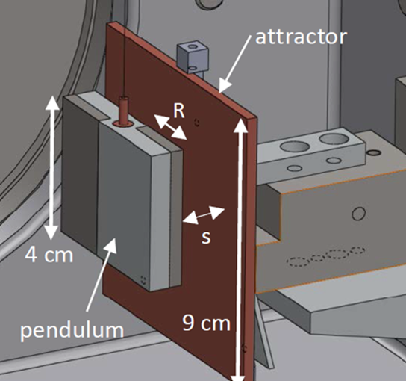
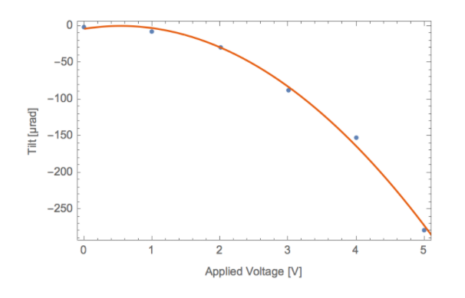
Novel Tests of Gravity Below Fifty Microns
F. Trombetta, K.R. Galaz, M.E. Gengo, A.M. Johnson, J.P. Mendez, E.N. Ord, C.J. Rogers, K.A. Weber, and C.D. Hoyle
Department of Physics and Astronomy
Humboldt State University, 1 Harpst Street, Arcata, California 95521
Motivation
Inverse-square Law
Our Current Projects
Physical processes regarding gravity are well understood on the scale of planetary distances but pose challenges in measurements at very short distances. Theories such as the Inverse Square Law (ISL) and Einstein’s Weak Equivalence Principle (WEP) of General Relativity have been tested over distance scales from 1 cm to infinity [1]. Reliable measurements of gravitational forces at scales smaller than a centimeter carry significant challenges. The non-gravitational forces that are generally negligible at the scale of everyday objects have a much more substantial effect in the sub-centimeter regime.
Some gravity models predict alterations of the gravitational ISL at sub-millimeter distances [1 - 3]. Others predict a violation of the WEP at some level due to interactions coupled to quantities other than mass, or modifications of gravity itself. Humboldt State University (HSU) experiments will have unprecedented sensitivity to search for deviations from Newtonian gravity in the 20-50 micron range.
One way to model deviations from the ISL is to add a Yukawa addition to the standard Newtonian potential energy [3] :
The Tilt Control group has been working on canceling out the change in tilt due to the movement of Science A each day. The tilt of the building throughout a day varies by 30 microradians, making it a large source of noise for the experiment. We are writing a LabView program that measures the current tilt of the apparatus and sends out a tilt correction voltage calculated by a PID loop to bring the tilt back to a setpoint value. This voltage is sent to a resistor on one of the legs of the apparatus and thermally expands or contracts the tilt back to the setpoint value.
λ - Length scale where a deviation from the ISL might occur
α - Strength of the potential deviation
Taking advantage of the slow down in data collection due to the pandemic, we are doing a major overhaul, rewriting the code from Python 2.7 to Python 3.8 with updated algorithms and a new modern interface. Our code is used to visualize the data and detect trends or signals from the noise.
A small project is using the current analysis program to look at data runs that were taken when the attractor mass was oscillating without the mass attached. If the analysis matches theoretical models, we will be able to be fairly confident that we have quieted the sources of noise at the scales we are concerned with.
Rotation
Stage
Translation Stage
Autocollimator
The blue curve represents the tilt of the Science building which varies throughout the course of the day by 30 microns due to the building’s old foundation. The Orange curve represents the capacity of our tilt correction system to help keep the experiment level with a tilt range of 300 microns as our applied voltage varies from 0 to 5 volts.
Torsion
Fiber
Pendulum
Above: Results from previous experiments, shown by the curves labeled Eöt-Wash [5,6], HUST [7, 8], and Irvine [9], produce the region in yellow which is excluded at the 95% confidence level. Each blue dashed line shows the predicted sensitivity of this apparatus for independent analyses of the first (1ω) and second (2ω) harmonic torque amplitudes. Improved constraints may be obtained by analyzing multiple harmonics together. The green dashed line is the current expected sensitivity of the apparatus. Note that for certain values of λ, an improvement by a factor of approximately 20 is obtained over previous efforts. The dashed curve crosses α = 1 at λ = 29 μm.
Membrane
Attractor
Experimental Methods
Weak Equivalence Principle
Acknowledgements
We extend a special thanks to Tyler Hooker, and all of the current and former students who have contributed to the HSU Gravitational Physics Laboratory.
HSU gravitational physics research is supported by the National Science Foundation (NSF) grants PHY-1065697, PHY-1306783, PHY-1606988, PHY- 1908502, Research Corporation grant CC6839, and internally by the HSU College of Natural Resources and Sciences, Sponsored Programs Foundation, and President’s Office. CSU-LSAMP is funded through the NSF under grant HRD-1302873 and the Chancellor's Office of the California State University.
The experiment essentially consists of a parallel-plate torsion pendulum and an attractor mass oscillating nearby at an angular frequency ω (the distance s, shown in the bottom right image in the figure above, is varied sinusoidally). As the attractor mass oscillates, the twist in the pendulum is measured and read out to the lab computers in real-time using an autocollimator.
An autocollimator combines a laser and a position-sensitive photodiode detector to measure tiny variations in the pendulum’s angle. The laser emitted from the autocollimator follows a path to the pendulum, then reflects off it and traces its way back to the photodiode detector. As the pendulum twists, the motion gets mirrored by the laser onto the photodiode detector. The measured amount of twist indicates a torque on the pendulum and will be compared to the Newtonian ISL prediction to search for deviations from expected behavior.
The WEP is tested through the pendulum’s composition by constructing the parallel plate pendulum out of two different materials with equal masses. In this context, it might help to think of the WEP as the Einstein equivalent to the Galilean assumption that a hammer and a feather would experience the same acceleration in freefall (astronauts on the moon verified this [4]). By making the pendulum out of two materials, it is made into a "composition dipole" that is sensitive to violations of the WEP as well as the ISL.
The WEP will be tested at short range using a composition dipole pendulum as shown below.
Pendulum
Ti
References
[1] E.G. Adelberger, J.H. Gundlach, B.R. Heckel, S. Hoedl and S. Schlamminger, Part. Nucl. Phys. 62 (2009) 102.
[2] R. Sundrum, Phys. Rev. D 69, 044014 (2004).
[3] E.G. Adelberger, B.R. Heckel and A.E. Nelson, Ann. Rev. Nucl. Part. Sci. 53 (2003) 77.
[4] https://moon.nasa.gov/resources/331/the-apollo-15-hammer-feather-drop/
[5] J.G. Lee, et al.,Phys. Rev. Lett.,124, 101101 (2020).
[6] D.J. Kapner, T.S. Cook, E.G. Adelberger, J.H. Gundlach, B.R. Heckel, C.D. Hoyle, and H.E. Swanson, Phys. Rev. Lett. 98, 021101 (2007).
[7] S.-Q. Yang et al., Phys. Rev. Lett. 108, 081101 (2012).
[8] W.-H. Tan et al., Phys. Rev. Lett. 116, 131101 (2016).
[9] J.K. Hoskins, R.D. Newman, R. Spero, and J. Schultz, Phys. Rev. D 32 (1985) 3084.
Al
Attractor Mass
As the attractor mass is oscillated, any interaction dependent on the composition difference of the right half of the pendulum would result in a modulation of the twist, and could be evidence of a short-range violation of the WEP..

