Slide 1
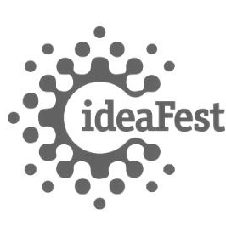
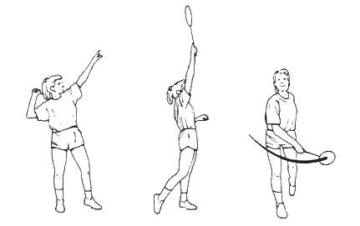
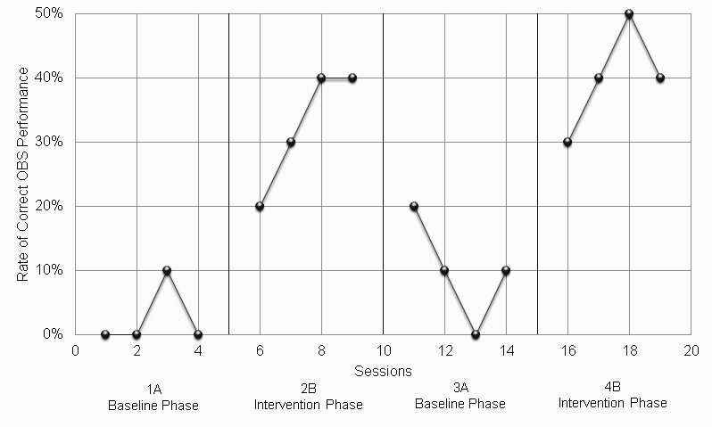
Effects of Visual and Verbal Prompting on the Badminton Overhand Swing
Anastasiya Yudinova, B.S.
Department of Kinesiology and Recreation Administration,
Humboldt State University, Arcata, CA
Abstract
The purpose of this study was to evaluate the effectiveness of verbal and visual prompting during balloon badminton on the number of correct overhand badminton swings (OBS), also known as a clear, of an 8-year-old female subject with spastic cerebral palsy. Using a 4-week ABAB design, the intervention was found to be effective at improving the rate of correctly performed OBSs by as much as 30% on a weekly average between baseline and intervention phases and by as much as 37.5% overall.
Social Significance
This intervention showed a functional relationship between visual and verbal prompting and quality of OBS performance of an 8-year-old female student with spastic cerebral palsy. The results could indicate that if the same intervention is extended, the subject may continue to experience improvements to her OBS performance. If verbal and visual prompting were to be applied to other types of badminton swings, the subject could develop necessary skills and increase the potential for joining the general physical education class at her school. In conjunction, additional evidence-based interventions, such as video modeling, can be utilized as a home training tool to further increase the participant’s badminton skills.
Purpose
The purpose of this study was to evaluate the effectiveness of verbal and visual prompting during balloon badminton on the number of correct overhand badminton swings.
Hypothesis
We hypothesized that both styles of prompting would be effective at improving the subject’s OBS performance according to the checklist (see Table 1) when used as needed in response to incorrect OBS execution.
Method
Participant
The participant was recruited from a special education classroom in Northern California. She was 8 years old with a diagnosis of spastic diplegia, a form of cerebral palsy, characterized by the inability to relax the muscles of the lower limbs (Cans et al., 2007). The subject’s motor function was categorized by the Gross Motor Function Classification System (GMFCS) as level IV, which differs from level III in that those individuals typically have severely limited walking ability even with assistive devices, and they typically cannot get around without a power wheelchair. However, unlike those in level V, individuals in level IV can generally sit up independently, hold up their head, and have limited voluntary control of limb motor function (Palisano et al., 1997). The participant had limited motor function of her lower limbs and used a powerchair, but she actively used her upper limbs for various activities within her classroom such as stacking blocks, coloring, and tossing a ball. The participant had the most mobility out of all the children in her special education classroom, leading to her often playing alone. Not accounting for the subject’s home selection, her daily access to toys, games, and equipment was restricted to what was present within the classroom and may have been a limiting factor in her motor control development opportunities, as well as her participation in physical activity with non-disabled peers. Based on observations made by her classroom staff, the participant struggled with quickly releasing objects held in her hands, aiming at targets, and producing appropriate and consistent amounts of force when throwing.
Dependent Variable
This study aimed to increase the number of correct OBSs by improving OBS performance.
Independent Variable
The intervention used during balloon badminton was a combination of verbal and visual prompting.
Research Design
Baseline
The baseline phases occurred during weeks 1A and 3A of this 4-week study. Balloon badminton was played Monday through Thursday at 11am. The location and time chosen was to reduce possible distractions or other influences on the participant (e.g., other kids talking or playing). At this hour, the school’s courtyard was empty and relatively quiet, and by running this study outside her classroom, we hoped to reduce potential peer influences on the participant and the study.
Each day of the baseline phases the subject was asked to complete 10 repetitions of the OBS, taking breaks as needed, during which time the number of correct swings was recorded by volunteers A or B. During the baseline data collection phases, verbal or visual prompting was not used.
Positive reinforcement was given to the participant upon successful completion of a swing (e.g., “That was a great swing!”), as in all A and B phases of this study. This aspect was not observed in the data collection process.
Intervention
The intervention phases occurred during weeks 2B and 4B. Balloon badminton continued to be played Monday through Thursday at 11am. The location and time remained the same as in the baseline phases (see above).
Each day of the intervention phases, the participant was once again asked to perform 10 repetitions of the OBS for data collection, However, this time verbal and visual prompting was initiated as needed throughout the game of 10 repetitions with the participant. Both prompting styles were used concurrently in response to an incorrect occurrence of any aspect of the OBS checklist (see Table 1). The specific prompts used to encourage correct performance corresponded to the appropriate steps of the OBS detailed in Table 1. Every complete and correct individual OBS, based on the checklist in Table 1, was recorded by a volunteer (A or B) as a single check mark in Table 3 (see complete paper).
Positive reinforcement was given to the participant upon successful completion of a swing (e.g., “That was a great swing!”), as in all A and B phases of this study. This aspect was not observed in the data collection process.
Note: This table represents the verbal and visual prompts used as the independent variables in this intervention.
Figure 3
Overhand Badminton Swing/ Clear
Note: This image depicts the overhand badminton swing, also called a clear.
Internal Validity
Internal validity was controlled for maturation due to the overall intervention length being only two weeks long and the total study being four weeks long, which was not likely to allow enough time for the child to change physiologically in a way significant enough to impact the results of this study. We safeguarded internal validity against instrumentation by following the established system of protocols (see Implementation Fidelity and Measurement Fidelity in complete paper). The following steps were adhered to:
The team followed a strict schedule of meetings and interactions (see Figure 2 in complete paper) with the subject on Mondays through Thursdays each week, for all four weeks, at 11 am. The same study environment (see Setting in complete paper) was maintained throughout all phases of this study.
The volunteers utilized verbal and visual prompting during game time only on weeks 2B and 4B, the phases of intervention implementation. Volunteer A and B switched roles as noted in the Intervention Phases section. This was done to reduce any potential impact of either volunteer’s personal characteristics and interaction style on the subject’s performance rate.
Data collection was performed during each game of balloon badminton, on every day of the study, in the form of check marks (see Table 3 in complete paper). Each check mark represented a single correct and complete OBS based on the checklist in Table 1, which outlines the required motions of what constitutes an OBS for a child with cerebral palsy using a powerchair. The data gathered was systematically analyzed and compared (see Table 4 in complete paper), and the results plotted for each day of the study (see Figure 1).
External Validity
The same intervention protocol used in this study can potentially have similar benefits on gross motor skills involving OBSs for other individuals with spastic diplegia. This protocol can also be modified to accommodate other gross or fine motor skills depending on the needs of the subject, improving their chances of participation in aspects of the general physical education curriculum.
Results
Participant
During week 1A, the baseline phase, the participant’s low level of training in the OBS was evident in the average percent of total accuracy of completed swings being at 2.5 %, with only 1 correctly completed swing that week. In week 2B, with the introduction of prompting, we see the average rate of correctly completed OBSs go up by 30%, a significant increase, and 13 correctly executed swings for the week. Week 3A, the intervention removed, shows a considerable decline in overall rate of accurately completed OBSs at 10%, only 3 more correct swings compared to week 1A, though still a 7.5% overall improvement from the first baseline data. During week 4B, once the intervention is reintegrated once again, we see the biggest rise in average correct execution of OBSs of all four weeks, at 40% and 16 correct swings. This is a 7.5 % increase from the first intervention implementation phase during week 2B, and a significant improvement by 37.5% overall in the participant’s OBS performance compared to the initial baseline.
Figure 1
Rate of Correct Overhand Badminton Swing
Note: This chart displays the rate of correct OBS execution over 16 sessions
Social Validity
The dependent variable within this study was the participant’s rate of accurate OBS performance. Based on the performance improvements we recorded, if this intervention was maintained over an extended period by classroom supporting staff or a trained peer, our prediction is that this intervention will continue to improve the subject’s OBS on an ongoing basis until she is able to perform all stages of this gross motor skill consistently without requiring prompting. Besides contributing to her confidence and a physically active lifestyle, badminton skill building increases the likelihood that the participant may join the general physical education class. The movement pattern required for the OBS can also translate to other activities the participant may have interest in, such as freestyle swimming, creating more future opportunities for physical activity and exercise participation.
The same intervention of verbal and visual prompts can be similarly used for other students with certain forms of cerebral palsy or modified to best suit the individual needs of the students based on the type of disability they have and the physical activity they are interested in. This intervention could be effective by itself or in conjunction with other evidence-based practices to improve a range of gross and fine motor skills of children with and without disabilities.
Implementation of this intervention requires minor training for technicians, volunteers, teachers, or peers, and little to no prior experience. No additional tools or costs are associated with this intervention, except basic supplies required for the performance of a sport or activity of interest. This intervention’s effectiveness is not impacted by time of day or physical environment characteristics, within reason, and it is flexible enough to allow researchers to choose when and where it could be implemented.
Discussion
The purpose of this study was to evaluate the effectiveness of verbal and visual prompting during balloon badminton on the number of correct overhand badminton swings. Unfortunately, similar studies, which investigate the effects of prompting during physical activity, particularly with students diagnosed with cerebral palsy, are difficult to find. However, many studies have been conducted in different settings with children with a variety of disabilities, which also use prompting as part of their interventions. The studies used for comparison all showed prompting to be an effective modality in skill learning and activity promotion for school-aged children with disabilities (Adams, 2018; Wahl-Alexander et al., 2020; Dieringer et al., 2017).
Similar to the present study, Adams (2018) used video and verbal prompting for different instructional conditions, along with direct instruction, to positively affect the overhand throw of several of his participants to varying degrees, deepening on the type of prompting they preferred. This reflects our hypothesis that an intervention consisting of verbal and visual prompts would be appropriate for improving a specific gross motor skill, such as an overhand throw or swing. We see similar positive results in a study by Wahl-Alexander et al. (2020), which found that verbal prompting, with or without the addition of a reward system, used to increase the number of steps made by each participant during a badminton class, led to 21-24% more steps when inactive students were prompted by the teacher. As in the present study, the use of prompting as a major modality to affect physical activity outcomes continues to be a viable option. We hypothesized that verbal prompting alone would not be as effective at improving the participant’s OBS performance as verbal and visual prompting combined. It is consistent with findings based on Dieringer et al. study (2017), where the most gross motor skill completion by participants was observed during the phase where modeling was added to music and verbal prompts during an activity.
Limitations
This study did not include filming the participant. Instead, the data was collected in real time by one trained volunteer. The lack of visual record for data comparison and cross-referencing results can be seen as a limitation of this study. The present study was only four weeks long. This can be seen as a limitation as a longer duration of this study could yield different, and, potentially, more dramatic results for the subject’s gross motor skills. This study was also done with only one participant, which does not allow for comparison of intervention effectiveness on different students with varying abilities. Additionally, the study only addresses one particular gross motor skill, and the intervention is tested on a very specific physical action, limiting the available evidence of its potential impact on other varieties of physical skills.
Future Research
The following changes can be made in future research:
Combine the present intervention with another evidence-based practice, such as video modeling, prior to using prompting during each trial.
Use a multiple baseline design across several participants to evaluate the effects of this intervention.
Use a multiple baseline design across several conditions to compare effects of this intervention on gross to fine motor skills.
All future participants can be filmed to provide a visual reference for accurate results assessment.
Perform a comparison study for the present intervention applied to typically developing students and those with disabilities.
Table 1
Verbal and Visual Prompts Used to Improve Performance of the Overhand Badminton Swing
Overhand Swing Criteria | Verbal & Visual Prompts
1. The racket body must rise above the subject’s head each time the racket is in the overhead position of a swing | “Racket high!” Volunteer demonstrates by holding their racket up overhead in accordance with checklist criterion
2. The racket body must swing back behind the subject’s head, fully clearing it during wind-up, before coming back forward | “Racket back!” Volunteer demonstrates by swinging their racket back from overhead in accordance with checklist criterion
3. The racket contacts the balloon | “Hit the balloon!” Volunteer demonstrates by touching a balloon to the racket
4. The racket and hand arc forward, fully clearing the head of the subject, when following through to the end of the swing | “Racket forward!” Volunteer demonstrates by swinging their racket forward from overhead in accordance with checklist criterion
Citations and the complete research paper available upon request.

