Slide 1
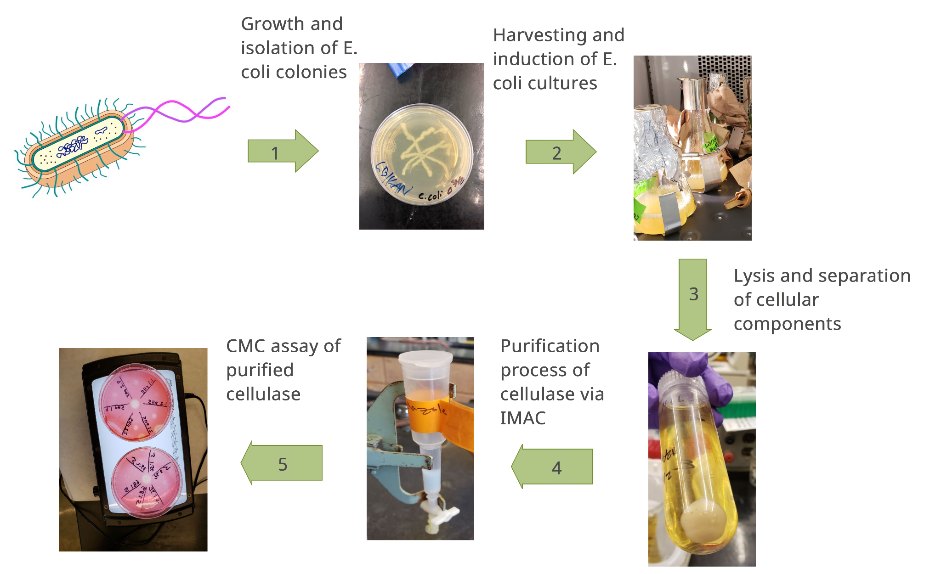
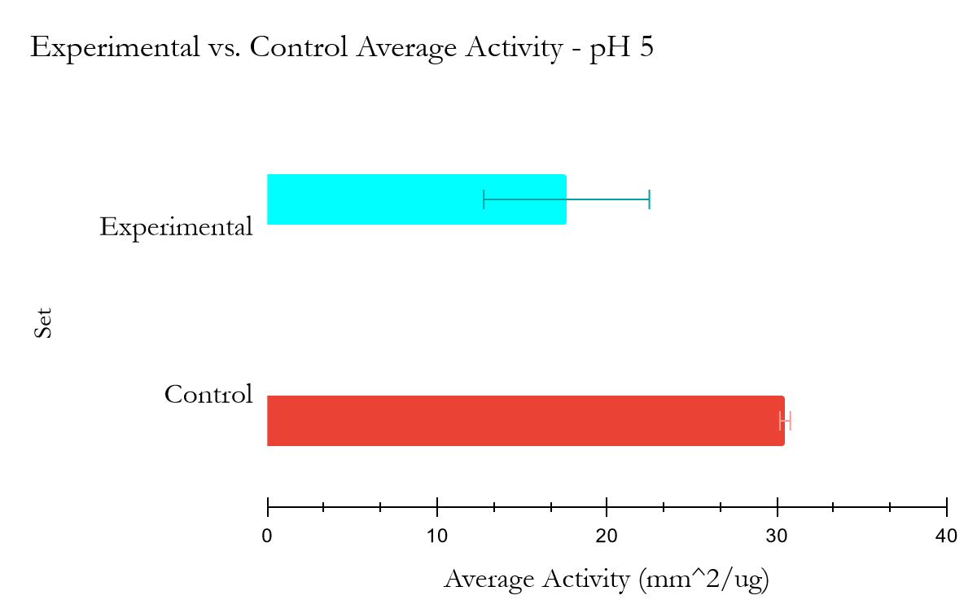
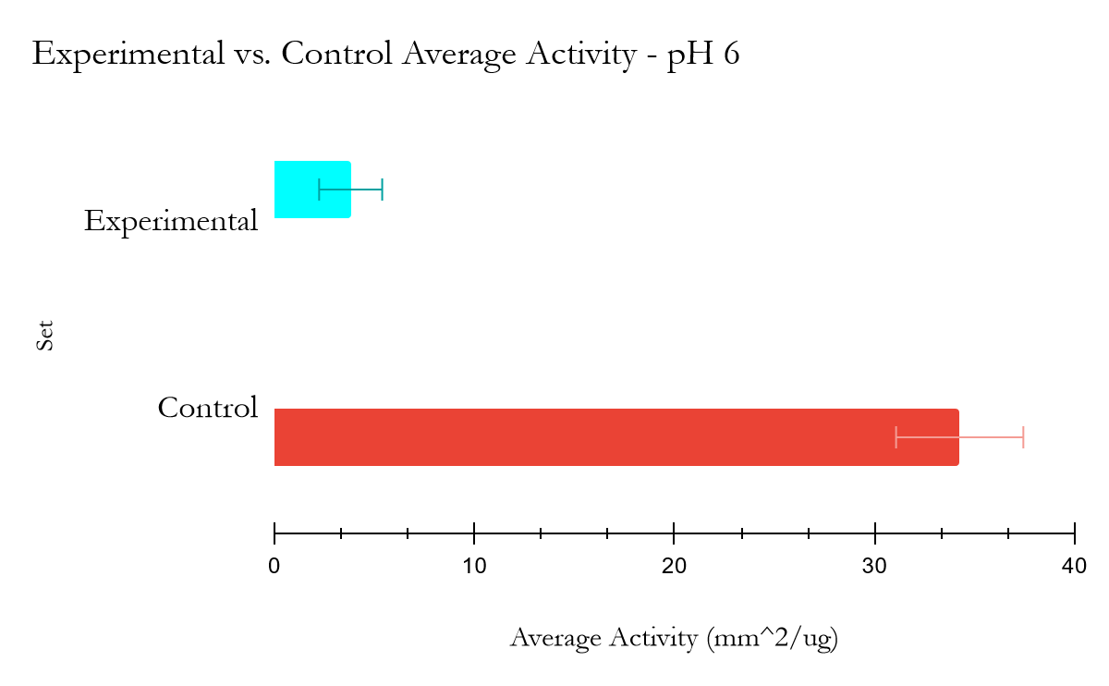
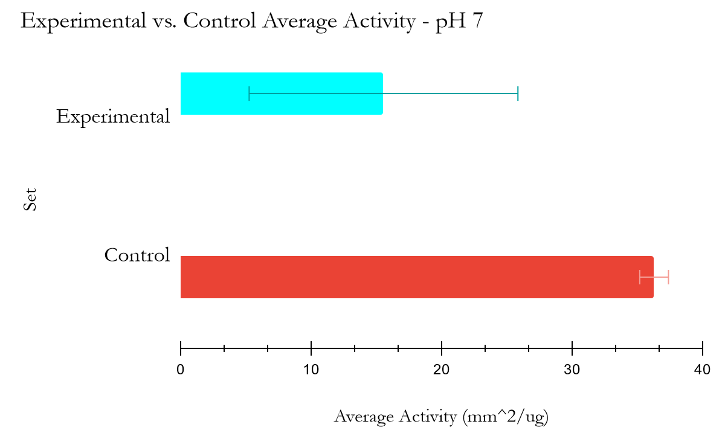
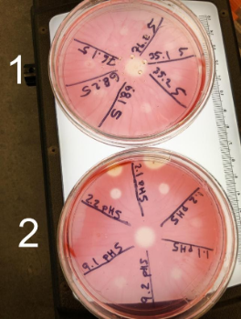
California
State University
SAN MARCOS
Novel Cellulases: pH and Activity
Annie Jensen, Tessa M. Balkow, Vincent D. Calderon, Aaron R. Darlington
Madison E. Kishineff, Jayden J. Losee, David A. Morales, Dr. Jenny Cappuccio
Department of Chemistry, Humboldt State University, Arcata, CA, USA
Abstract
Methods
Discussion
Utilizing cellulase enzymes can enhance the production of biofuels. In this study, 6 cellulases identified through metagenomic analysis of cow rumen were expressed in E. Coli, purified using immobilized metal affinity chromatography (IMAC), and then assessed for enzymatic activity versus a control cellulase isolated from Aspergillus Niger. To do this, we evaluated the breakdown of carboxymethyl cellulose (CMC) in a plate assay with Congo Red detection. 4 with high activity and 2 with low activity were selected for analyzing the effective pH on the enzymatic activity and expanding the research to kinetic analysis. The activity ratios (exp:ctrl) were found to be 0.58 ± 0.16, 0.111 ± 0.047, and 0.429 ± 0.29 for pH 5, 6, and 7 respectively. This indicates that the cellulases, on average, had the highest activity at pH 5. This research could inform new cellulase design and enhance biofuel production.
6 E. Coli strains with LAC dependent pET-28 vectors coding for 6 putative cellulases were grown.
The strains were induced with IPTG to overexpress the recombinant proteins.
The cells were lysed and the lysate was applied to a Ni-NTA column.
The recombinant proteins were placed on CMC plates stained with Congo Red (which is red only when bound to CMC).
The areas on the plates that were decolored (and therefore cleared of CMC) were measured to assess enzymatic activity.
Experimental cellulases demonstrated the lowest activity at pH 6. pH 7 and pH 5 elicited higher activity.
This may indicate that pH 5 is the digestive pH.
Respective buffer species may contribute to the hydrolysis capacity of enzymes.
The vast majority of cellulases did not exceed the activity of the control.
With the exception of #9, these novel cellulases did not display enough activity to merit future study.
Acknowledgements:
the research was partially funded by United States Department of Energy Joint Genome Institute Grant CSP-506518.
Introduction
Figure 2. Flowchart illustrating the CMC plate assay procedure.
Future Work
Ruminant derived cellulases can be highly effective. ¹
The identities and concentrations of cellulases produced by ruminant digestive bacteria vary widely; even animals of the same species grazing on the same field have significant variations in the cellulases produced by their bacterial ecosystems.²
Therefore, further bioprospecting is worthwhile.
A ruminant cellulase more effective than Cell-5M may yet be discovered.
Some cellulases can function relatively well over a wide range of pHs, other cellulases only exhibit activity over a narrow pH range.³
Our cellulases were found lacking in activity when assessed previously at pH 8.
The pH range of the cow’s rumen fluctuates daily between 5 and 8.⁴
We hypothesized that our cellulases will display more activity at a lower pH.
To test our hypothesis, novel putative cellulases expressed in E. Coli with the addition of a 6xHis tag were purified with a Ni-NTA column, then assessed for enzymatic activity at pHs 5, 6, and 7 through the use of semi-quantitative carboxymethylcellulose (CMC) plate assays.
Version:0.9 StartHTML:00000097 EndHTML:00000167 StartFragment:00000131 EndFragment:00000131
Results
pH is not the only factor that can affect the activity of an enzyme. The growth conditions of the E. Coli expression system, the concentration of various metallic and organic cofactors present during and after expression, and the temperature of the system during catalysis are all factors that can be modified and potentially optimized.
Kinetic analysis of enzymes will also enhance our understanding of these proteins.
The digestive systems of other ruminants, like beavers, may also be the subject of bioprospecting in the future.
Citations
(1) Patel, M., Patel, H. M., and Dave, S. (2020) Determination of bioethanol production potential from lignocellulosic biomass using novel Cel-5m isolated from cow rumen metagenome. Int. J. Biol. Macromol. 153, 1099–1106.
(2) Fon, F. N., Nsahlai, I. V., Scogings, P. F., and Basha, N. A. D. (2014) In vitro cellulase production from five herbivore microbial ecosystems and consortia. Ann. Anim. Sci. 14, 329–340.
(3) Li, Q., Loman, A. Al, Callow, N. V., Islam, S. M. M., and Ju, L. K. (2018) Leveraging pH profiles to direct enzyme production (cellulase, xylanase, polygalacturonase, pectinase, Α-galactosidase, and invertase) by Aspergillus foetidus. Biochem. Eng. J. 137, 247–254.
(4) Ambriz-Vilchis, V., Jessop, N. S., Fawcett, R. H., Webster, M., Shaw, D. J., Walker, N., and Macrae, A. I. (2017) Effect of yeast supplementation on performance, rumination time, and rumen pH of dairy cows in commercial farm environments. J. Dairy Sci. 100, 5449–5461.
Figure 1. Semi-quantitative Cellulase activity. Example carboxymethyl cellulose substrate plate assay using congo red detection. Clearing indicates enzyme activity. The control commercial cellulase is shown in the middle.
Figure 3. Average activity of experimental vs control cellulases. The error bar represents SD. The activity ratios (exp:ctrl) were found to be 0.58 ± 0.16, 0.111 ± 0.047, and 0.429 ± 0.29 for pH 5, 6, and 7 respectively.

Slide 2
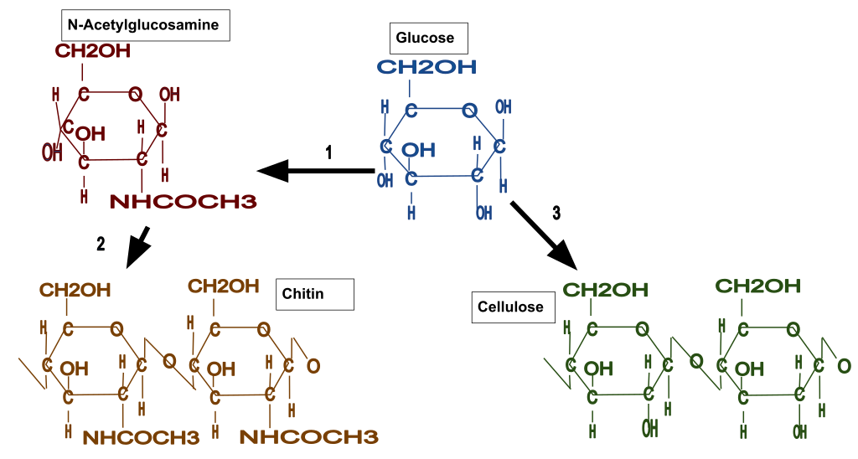
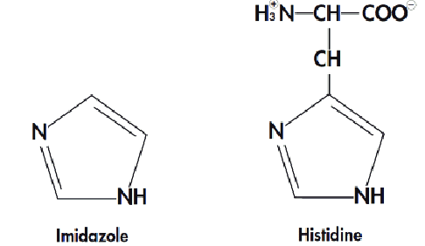

Slide 4
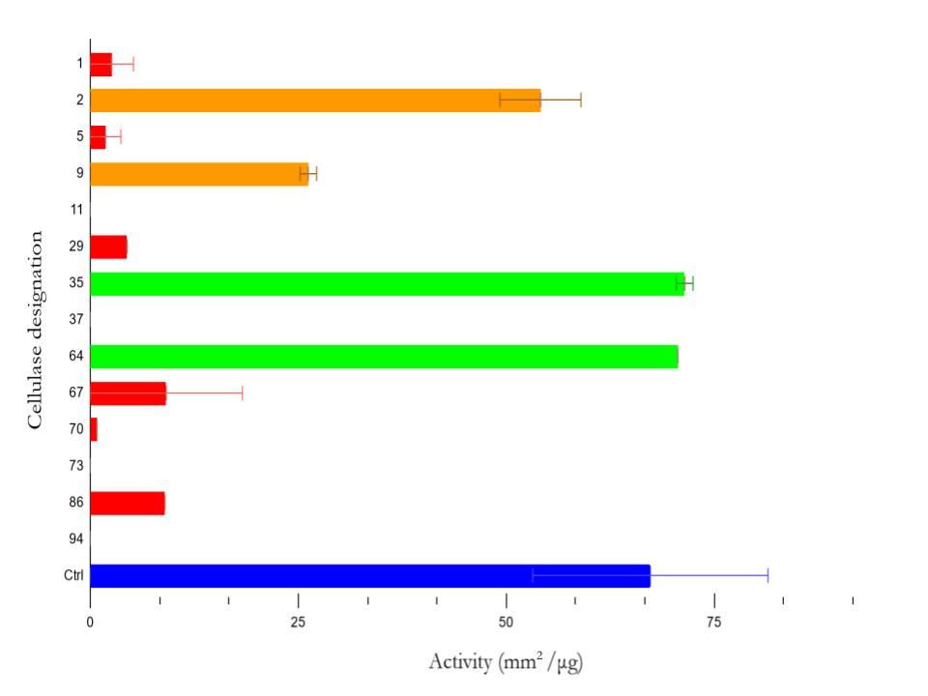
Novel Cellulases: pH and Activity
Annie Jensen, Tessa M. Balkow, Vincent D. Calderon, Aaron R. Darlington
Madison E. Kishineff, Jayden J. Losee, David A. Morales, Dr. Jenny Cappuccio
Department of Chemistry, Humboldt State University, Arcata, CA, USA
Abstract
Methods
Discussion
Cows digest cellulose in their rumens with the aid of microbially produced cellulase. Cellulase breaks down cellulose into glucose. which can then be fermented by yeast to produce ethanolic biofuel. In this study, cellulases identified through metagenomic analysis of the contents of a cow’s rumen were tested for their ability to hydrolyze cellulose. To do this, the putative cellulases were expressed in E. Coli, then purified and assessed for enzymatic activity against an Aspergillus Niger control using carboxymethylcellulose (CMC) plate assays. The results of the new analysis at pHs 5, 6 and 7 are still pending. They will be compared to the results obtained previously at pH 8, which are reported here.
6 E. Coli strains with LAC dependent pET-28 vectors coding for 6 putative cellulases were grown.
The strains were induced with IPTG to overexpress the recombinant proteins.
The cells were lysed and the lysate was applied to a Ni-NTA column.
The recombinant proteins were placed on CMC plates stained with Congo Red (which is red only when bound to CMC).
The areas on the plates that were decolored (and therefore cleared of CMC) were measured to assess enzymatic activity.
Of the 14 cellulases previously evaluated, four showed no activity at all (see Figure 1). Of those that did show activity, only 4 showed any appreciable activity and of those 4 only 2 showed more activity than the A. Niger control. #1, #2, #9, #35, #64, #70 were the cellulases selected for further study. Two cellulases of each activity level were chosen. #64 and #35 had high activity, #2 and #9 had medium activity and #1 and #70 had low activity. It will interesting to see how these cellulases respond to lower pHs.
Introduction
Results
Future Work
Ruminant derived cellulases can be highly effective. A novel endocellulase (Cell-5M) discovered in 2020 through the metagenomic analysis of the microbiome of a cow’s rumen was used to successfully produce biofuel. While the wheat straw used needed to be pre-treated with alkali and steam, the ethanol yield was significant.¹
The identities and concentrations of cellulases produced by ruminant digestive bacteria vary widely; even animals of the same species grazing on the same field have significant variations in the cellulases produced by their bacterial ecosystems.² Therefore, further bioprospecting is worthwhile. A ruminant cellulase more effective than Cell-5M may yet be discovered.
While some cellulases can function relatively well over a wide range of pHs, other cellulases only exhibit activity over a narrow pH range.³ Our cellulases were found lacking in activity when assessed previously at pH 8. The pH range of the cow’s rumen fluctuates daily between 5 and 8.⁴ We hypothesized that our cellulases will display more activity at a lower pH.
To test our hypothesis, novel putative cellulases expressed in E. Coli with the addition of a 6xHis tag were purified with a Ni-NTA column, then assessed for enzymatic activity at pHs 5, 6, and 7 through the use of semi-quantitative carboxymethylcellulose (CMC) plate assays.
The results of the current study are still pending. Reported here are the activities of the 14 cellulases previously evaluated for activity at pH 8. Strains #35 and #64 had activities of 72 ± 1 mm²/μg and 71 ± 0 mm²/μg respectively, which were both slightly higher than the A. Niger control.
pH is not the only factor that can affect the activity of an enzyme. The growth conditions of the E. Coli expression system, the concentration of various metallic and organic cofactors present during and after expression, and the temperature of the system during catalysis are all factors that can be modified and potentially optimized. The digestive systems of other ruminants, like beavers, may also be the subject of bioprospecting in the future.
Citations
(1) Patel, M., Patel, H. M., and Dave, S. (2020) Determination of bioethanol production potential from lignocellulosic biomass using novel Cel-5m isolated from cow rumen metagenome. Int. J. Biol. Macromol. 153, 1099–1106.
(2) Fon, F. N., Nsahlai, I. V., Scogings, P. F., and Basha, N. A. D. (2014) In vitro cellulase production from five herbivore microbial ecosystems and consortia. Ann. Anim. Sci. 14, 329–340.
(3) Li, Q., Loman, A. Al, Callow, N. V., Islam, S. M. M., and Ju, L. K. (2018) Leveraging pH profiles to direct enzyme production (cellulase, xylanase, polygalacturonase, pectinase, Α-galactosidase, and invertase) by Aspergillus foetidus. Biochem. Eng. J. 137, 247–254.
(4) Ambriz-Vilchis, V., Jessop, N. S., Fawcett, R. H., Webster, M., Shaw, D. J., Walker, N., and Macrae, A. I. (2017) Effect of yeast supplementation on performance, rumination time, and rumen pH of dairy cows in commercial farm environments. J. Dairy Sci. 100, 5449–5461.
Figure 1. Averaged activities of 14 cellulases from previously done CMC plate assays at pH 8. Green bars indicate an activity higher than the A. Niger control. The error bars represent standard deviation.

